Slide 1


Slide 2
What is Version Control System?
A software utility that tracks and manages changes to a ﬁlesystem.
Also known as revision control or source control system
It's a management of changes to documents, computer programs, large websites and other collection of information

Slide 3
What is Version Control System?
A VCS also offers collaborative utilities to share and integrate these ﬁlesystem changes to other VCS users.
VCS will track the addition, deletion, and modiﬁcation actions applied to ﬁles and directories
A repository is a VCS term which describes when VCS is tracking a ﬁlesystem.

Slide 4
What is Version Control System?
VCS options include Git, Mercurial, SVN and preforce.
You can think of a VCS as a kind of “database”.
It lets you save a snapshot of your complete project at any time you want
When you later take a look at an older snapshot your VCS shows you exactly how it differed from the previous one

Slide 5
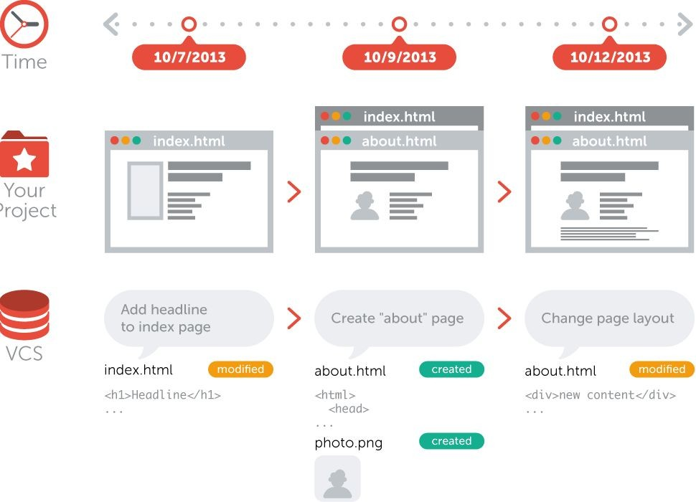

Slide 6
What is Version Control System?
Version control is independent of the kind of project / technology / framework you‘re working with
It works just as well for an HTML website as it does for a design project or an iPhone app
It lets you work with any tool you like; it doesn‘t care what kind of text editor, graphics program, ﬁle manager or other tool you use

Slide 7
Why Use a Version Control System?
Collaboration
Without a VCS in place, you‘re probably working together in a shared folder on the same set of ﬁles.
And you have to coordinate with others so that they don’t work on same ﬁle, it will be very diﬃcult to manage
With a VCS, everybody on the team is able to work absolutely freely
- on any ﬁle at any time.
The VCS will later allow you to merge all the changes into a
common version.

Slide 8
Why Use a Version Control System?
Storing Versions (Properly)
Saving a version of your project after making changes is an essential habit. But without a VCS, this becomes tedious and confusing very quickly:
How much do you save? Only the changed ﬁles or the complete project?
How do you name these versions? “myapp_2013-11-12_v23”
The most important question: How do you know what exactly is different in these versions?

Slide 9
Why Use a Version Control System?
Storing Versions (Properly) (cont…)
Version control system acknowledges that there is only one project
Therefore, there‘s only the one version on your disk that you‘re currently working on
Everything else - all the past versions and variants - are neatly packed up inside the VCS
When you need it, you can request any version at any time and you‘ll have a snapshot of the complete project right at hand.

Slide 10
Why Use a Version Control System?
Restoring Previous Versions
Being able to restore older versions of a ﬁle or whole project
If the changes you‘ve made
lately prove to be garbage, you can simply undo them in a few clicks

Slide 11
Why Use a Version Control System?
Understanding What Happened
Every time you save a new version of your project, your VCS requires you to provide a short description of what was changed
Additionally (if it‘s a code / text ﬁle), you can see what exactly was changed in the ﬁle‘s content

Slide 12
Why Use a Version Control System?
Backup
A side-effect of using a distributed VCS like Git is that it can act as a backup
every team member has a full-blown repository of the project on his disk
If central server break down (and your backup drives fail), all you need for recovery is one of your teammates’ local Git repository.

Slide 13
VSS
Different Types Of Version Control Systems
SVN
GIT

Slide 14
One of the most popular version Control systems today is Git. Git is a distributed
GIT
version-control system for tracking changes in source code during software development. It is designed for coordinating work among programmers, but it can be used to track changes in any set of ﬁles.

Slide 15
Centralized Version Control System (CVCS)
Types of Version Control Systems
Distributed Version Control System (DVCS)

Slide 16
Centralized Version Control System (CVCS)
Centralized version control system (CVCS) uses a central server to store all ﬁles and enables team collaboration. It works on a single repository to which users can directly access a central server.

Slide 17
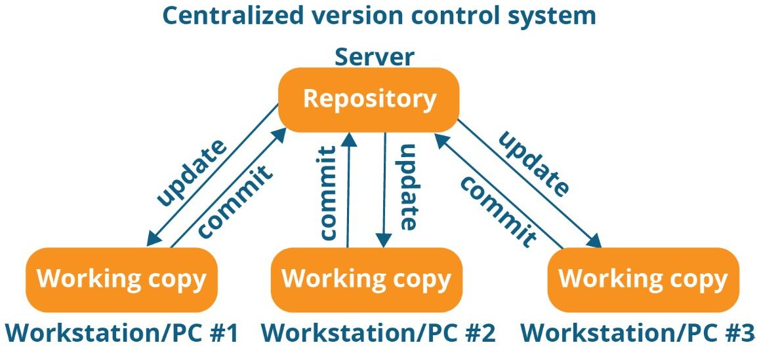

Slide 18
Centralized Version Control System (CVCS)
Every programmer can extract or update their workstations with the data present in the repository or can make changes to the data or commit in the repository. Every operation is performed directly on the repository.

Slide 19
It is not locally available; meaning you always need to be connected to a network to perform any action.
CVCS Drawbacks
Since everything is centralized, in any case of the central server getting crashed or corrupted will result in losing the entire data of the project.

Slide 20
Distributed Version Control System (DVCS)
These systems do not necessarily rely on a central server to store all the versions of a project ﬁle.

Slide 21
Distributed Version Control System (DVCS)
In Distributed VCS, every contributor has a local copy or “clone” of the main repository i.e. everyone maintains a local repository of their own which contains all the ﬁles and metadata present in the main repository.

Slide 22
Distributed Version Control System (DVCS)
GIT is Distributed version Control System

Slide 23
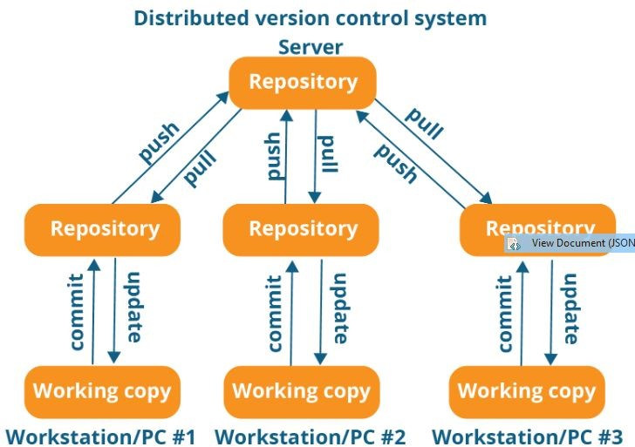

Slide 24
Distributed Version Control System (DVCS)
Every programmer maintains a local repository on its own, which is actually the copy or clone of the central repository on their hard drive. They can commit and update their local repository without any interference

Slide 25
Distributed Version Control System (DVCS)
Programmer can update their local repositories with new data from the central server by an operation called “pull” and affect changes to the main repository by an operation called “push” from their local repository.

Slide 26
Distributed Version Control System (DVCS)
All operations (except push & pull) are very fast because the tool only needs to access the hard drive, not a remote server. Hence, you do not always need an internet connection.
Advantages

Slide 27
Distributed Version Control System (DVCS)
Committing new change-sets can be done locally without manipulating the data on the main repository. Once you have a group of change-sets ready, you can push them all at once.
Advantages

Slide 28
Distributed Version Control System (DVCS)
Since every contributor has a full copy of the project repository, they can share changes with one another if they want to get some feedback before affecting changes in the main repository.
Advantages

Slide 29
Distributed Version Control System (DVCS)
If the central server gets crashed at any point of time, the lost data can be easily recovered from any one of the contributor’s local repositories.
Advantages

Slide 30
Git is a distributed
version-control system for tracking changes in source code during software development
Git
Everything we learned about Distributed version control system is applicable on GIT

Slide 31
Installing and Setting Up Git
Go to https://git-scm.com/downloads
Installation Guide:
https://git-scm.com/book/en/v2/Getting-Started-Installi ng-Git
For Linux:
https://git-scm.com/download/linux
For Windows:
https://git-scm.com/download/win

Slide 32
Installing and Setting Up Git
For windows after download
Double click on exe ﬁle and follow the installation wizard
Do not change anything just keep the default setting and press next on every step
It will install git on your machine

Slide 33
Installing and Setting Up Git
Open Terminal and run following commands to setup your name and email id
git conﬁg --global user.name “Your Name”
git conﬁg --global user.email “Your Email”

Slide 34
Installing and Setting Up SmartGit GUI Tool
Go to https://www.syntevo.com/smartgit/download
Download SmartGit
Install SmartGit with all default settings

Slide 35
Basic operations in Git are
Initialize
Add
Commit
Pull
Push

Slide 36
Advanced Git operations
Branching
Merging
Rebasing

Slide 37
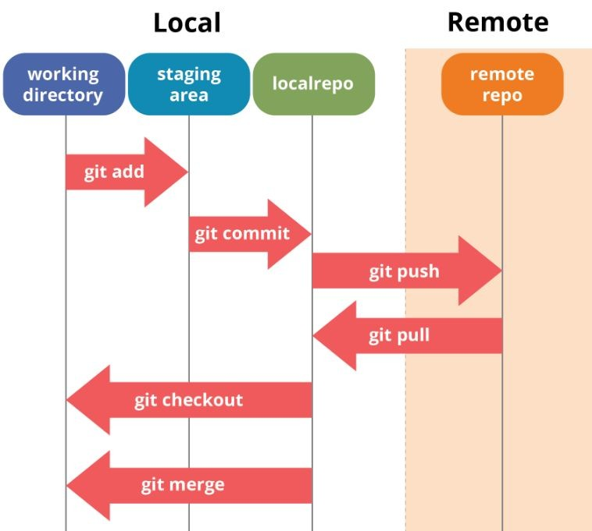
Git Operations

Slide 38
Important Terms
Think of a repository as a kind of database where your VCS stores all the versions and metadata that accumulate in the course of your project.
In Git, the repository is just a simple hidden folder named “.git” in the root directory of your project
1. Repository

Slide 39
Important Terms
The root folder of your project is often called the “working copy” (or “working directory”). It‘s the directory on your local computer that contains your project‘s ﬁles.
2. Working Directory

Slide 40
Important Terms
3. File Status

Slide 41
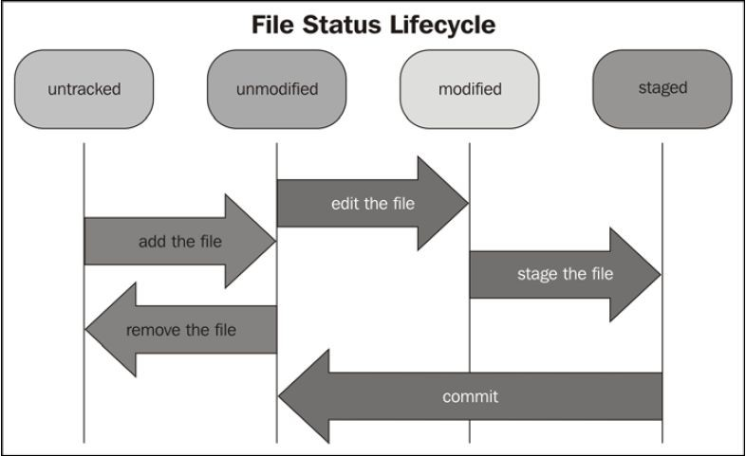

Slide 42
Staging area is a virtual place that collects all the ﬁles you want to include in the next commit
Important Terms
4. Staging Area
In Git, simply making some changes doesn‘t mean they‘re automatically committed.

Slide 43
Every commit is
Important Terms
4. Staging Area
“hand-crafted”: each change that you want to include in the next commit has to be marked explicitly (“added to the Staging Area” or, simply put, “staged”)

Slide 44
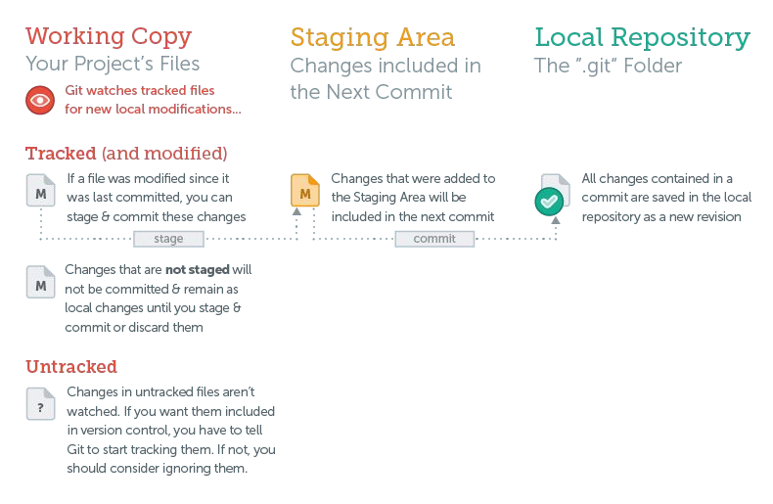

Slide 45
Basic Workﬂow

Slide 46
Starting with an Unversioned, Local Project
Open terminal and create directory on your machine
C:\Repo\myproject
Go into directory in terminal
Initialize repository in this directory
git init
This will create .git hidden folder in your directory which will make your current folder, a git repository

Slide 47
Starting with an Unversioned, Local Project
Create ﬁrst.txt and second.txt
Check status, it will show you two untracked ﬁles
git status
Add these ﬁles to staging area
Two ways to add ﬁles in staging
git add ﬁrst.txt second.txt OR
git add .

Slide 48
Starting with an Unversioned, Local Project
Commit your ﬁles to VCS with commit message
git commit -m “implemented new feature”
Commit message is very important, you should provide proper commit message so that it can be refer back to identify what was added in that commit
Check logs to see commit history
git log

Slide 49
Demo with Terminal

Slide 50
Demo with Smartgit UI

Slide 51
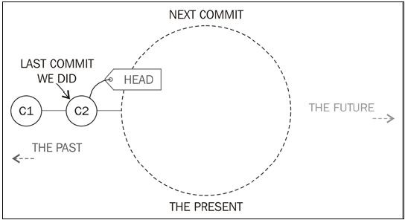
HEAD shows last commit

Slide 52
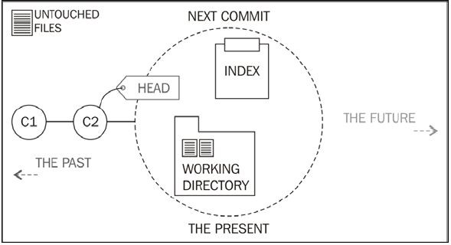
New and changed ﬁles will be part of next commit

Slide 53
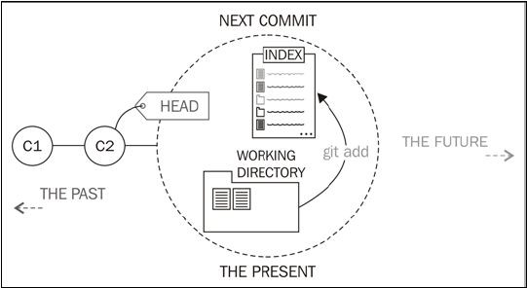
git add command add ﬁles in staging area

Slide 54
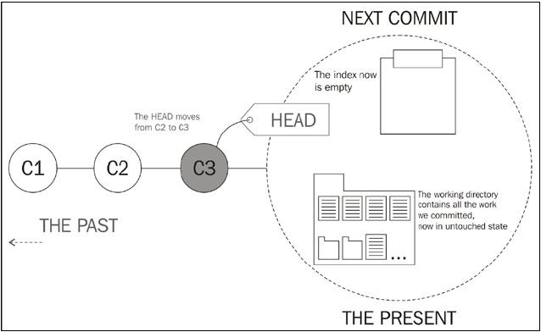
After commit, our new commit will be HEAD

Slide 55
Commit Hash
Every commit has a unique identiﬁer: a
40-character checksum called the “commit hash”.

Slide 56
Commit Hash
As multiple people can work in parallel, committing their work oﬄine, without being connected to a shared repository
Therefore commit Hash helps in identifying which user made speciﬁc commit

Slide 57
git reset
git reset command will remove ﬁle from staging area
git reset can remove changes in ﬁles if the are not commited
Unstage ﬁles or remove change

Slide 58
git reset
Unstage ﬁles or remove change
git rest
git reset --hard

Slide 59
Demo with Terminal

Slide 60
Demo with Smartgit UI

Slide 61
Typically, in every project and on every platform, there are a couple of ﬁles that you don‘t want to be version controlled
E.g
.DS_Store
Node_modules
Build
logs
Ignoring Files

Slide 62
Create an empty ﬁle in your favorite editor and save it as ”.gitignore” in your project‘s root folder.
You can deﬁne rules in “.gitignore” ﬁle to ignore ﬁles
Add ﬁle or directory path or extension or name
Ignoring Files

Slide 63
Ignoring Files -- Examples
Ignore one speciﬁc ﬁle
path/to/ﬁle.ext
Ignore all ﬁles with a certain name (anywhere in the project)
ﬁlename.ext
Ignore all ﬁles of a certain type (anywhere in the project)
*.ext
Ignore all ﬁles in a certain folder:
path/to/folder/*

Slide 64
Demo with Terminal

Slide 65
Demo with Smartgit UI

Slide 66
Branching and Merging

Slide 67
Why branches are important
In every project, there are always multiple different contexts where work happens
Each feature, bugﬁx, experiment, or alternative of your product is actually a context of its own
There can me unlimited amount of different contexts
Most likely, you‘ll have at least one context for your “main” or “production” state, and another context for each feature, bugﬁx, experiment, etc.

Slide 68
Why branches are important
In real-world projects, work always happens in multiple of these contexts in parallel:
While you‘re preparing two new variations of your website‘s design (context 1 & 2)
you‘re also trying to ﬁx an annoying bug (context 3).
On the side, you also update some content on your FAQ pages (context 4)
one of your teammates is working on a new feature for your shopping cart (context 5)
and another colleague is experimenting with a whole new login functionality (context 6).

Slide 69
Why branches are important
Another example
Production, development and feature context
Production code is tested and deployed and we don’t want any problem in that
Development team is working on new feature and we don’t want that feature to effect production code until it is properly tested
All feature combines in development to have ﬁnal testing before deployment

Slide 70
Branches are what we need to solve context problems.
Because a branch represents exactly such a context in a project and helps you keep it separate from all other contexts.
Branches to the Rescue

Slide 71
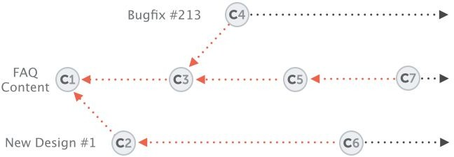
Branches to the Rescue

Slide 72
Branches to the Rescue
All the changes you make at any time will only apply to the currently active branch; all other branches are left untouched
This gives you the freedom to both work on different things in parallel and, above all, to experiment - because you can‘t mess up!
In case things go wrong you can always go back / undo / start fresh / switch contexts

Slide 73
Working with Branches
Without knowing, we were already working on a branch.
This is because branches aren‘t optional in Git: you are always working on a certain branch (the currently active, or “checked out”, or “HEAD” branch).
Check ‘git status’ and it will show you current branch
The “master” branch was created by Git automatically for us when we started the project.

Slide 74
Working with Branches
‘master’ branch does not mean anything special
It is initially created when we start project
‘HEAD’ always represent current branch

Slide 75
git branch
Show list of branches
git branch -v
Branch Commands
Show list of branches with some details
git branch new-dev
Creates new branch with name ‘new-dev’
Git checkout new-dev
Switch to ‘new-dev’ branch

Slide 76
git merge new-dev
Merge ‘new-dev’ branch into current active branch
git log new-dev..master
Show commit difference in two branches
Branch Commands

Slide 77
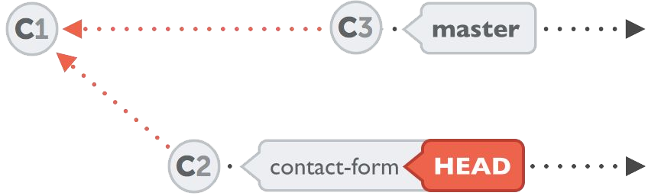
git checkout contact-form
git checkout move you to other branch and HEAD represent that branch

Slide 78
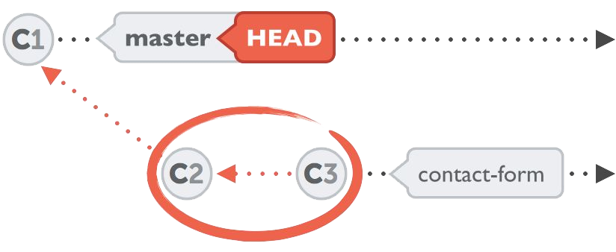
Merging Changes
You can merge all your commits in your branch into another branch by git merge command

Slide 79
Demo with Terminal

Slide 80
Demo with Smartgit UI

Slide 81
Commit wraps up changes and saves them permanently in the repository
Stash save changes
temporarily
Stash

Slide 82
If you want to switch to another branch without commiting changes in current branch
You will need to save your changes somewhere so that you have clean working directory
Stash will work in this case
Stash

Slide 83
Stash
Later, at any time, you can restore the changes from stash in your working copy - and continue working where you left off.
You can create as many Stashes as you want

Slide 84
git stash
Save local changes stash clipboard
git stash save <name>
Save local changes in stash clipbaord with the name provided in command
git stash list
Show list of stashes
Stash Commands

Slide 85
git stash pop
Apply latest stash and remove it from clipboard
git stash apply stashname
Apply speciﬁc stash and that stash will remain saved in clipboard
Stash Commands

Slide 86
Demo with Terminal

Slide 87
Demo with Smartgit UI

Slide 88
Short-Lived / Topic Branches
They are about a single topic or feature and once work done with them they are removed

Slide 89
Branch that are higher level and independent of any feature, remain for longer time
They represent states in your project lifecycle - like a
“production”, “testing”, or “development” state
Long-Running Branches

Slide 90
Remote Repositories

Slide 91
Remote Repositories
About 90% of version control related work happens in the local repository: staging, committing, viewing the status or the log/history, etc.
If you're the only person working on your project, chances are you'll never need to set up a remote repository.
Only when it comes to sharing data with your teammates, a remote repo comes into play.

Slide 92
Remote Repositories
Think of it like a "ﬁle server" that you use to exchange data with your colleagues.
Local repositories reside on the computers of team members. In contrast, remote repositories are hosted on a server that is accessible for all team members - most likely on the internet or on a local network.

Slide 93
Remote Repositories
For remote repository you have to ﬁrst select the online service that offer git and allow you to create remote repository
Following are few online services:
GitHub (https://github.com)
BitBucket (https://bitbucket.org)
GitLab (https://gitlab.com)
Many others

Slide 94

Github is online service for git to create remote repositories on github’s server and collaborate with teammates/colleague

Slide 95
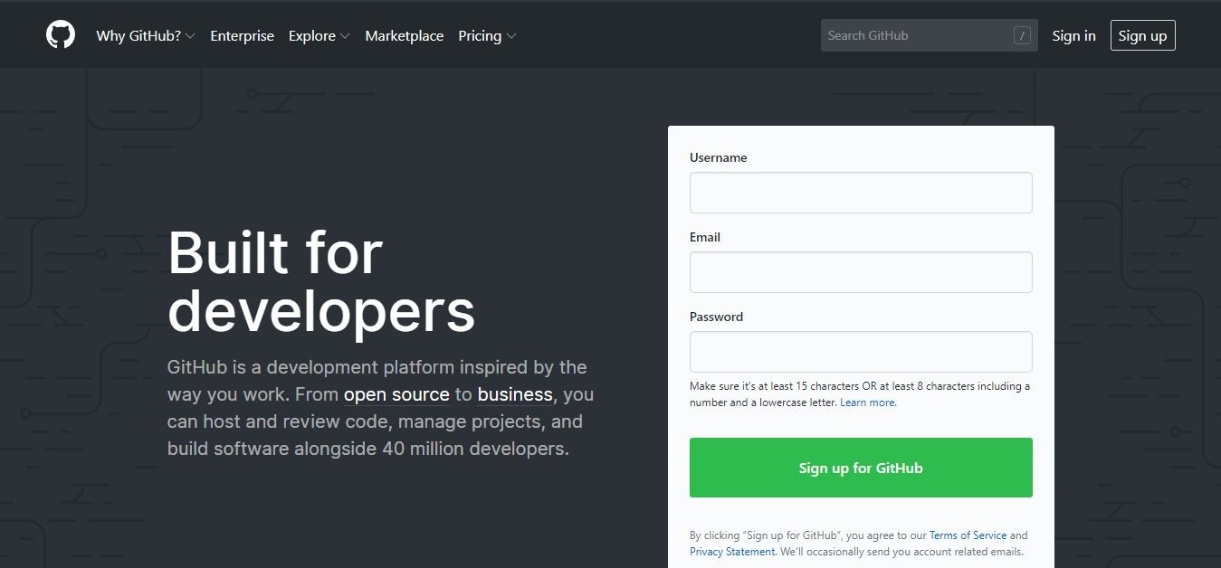
Setting up a new GitHub account

Slide 96
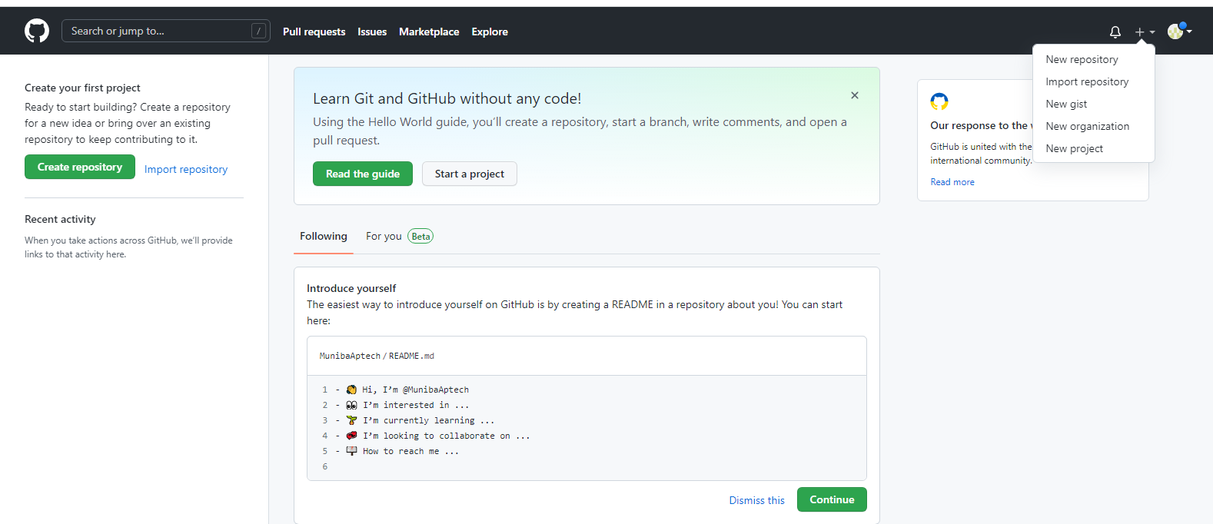
Create New Repository

Slide 97
Create New Repository

Slide 99
Cloning a repository
Copy the url in popup

Slide 100
Cloning a repository
Go to the local root folder, C:\Repos, for the repositories.
Open a terminal within it.
Type git clone https://github.com/MunibaAptech/MyProject.git

Slide 101
Work on remote repository
After clone, make changes to your project on your local machine
Add ﬁle or change a ﬁle
Add ﬁle to staging area by git add .
Commit ﬁle git commit -m “updated feature”
Run command “git push” to push your change to remote repository on server

Slide 102
git push
Push changes to remote repository
git fetch
Commands to interact remote repository
Fetch changes from remote repository
git merge
Merge changes that was fetch by ‘git fetch’ command

Slide 103
git pull
Commands to interact remote repository
Fetch and merge changes from remote repository
git remote -v
Show remote urls
git remote show origin
Show details of origin

Slide 104
Commands to interact remote repository
“git remote add myremote https://github.com/zeesh anhanif/MyProject.git”
This command will add remote repo in local repository

Slide 105
Demo Basic clone and push pull with Terminal

Slide 106
Demo Basic clone and push pull with Smartgit UI

Slide 107
Publish a local repository to GitHub
If you already have local repository on your machine and want to connect it with remote repository then:
Create repository on github
Open terminal in your local repository
Run following command
git remote add origin https://github.com/zeeshanhanif/MyProject.git
git push -u origin master

Slide 108
Publish a local repository to GitHub
git push -u origin master
The “-u” ﬂag establishes a tracking connection between remote and our local

Slide 109
git push ‘remote’ ‘branch’
git push origin master
Git push command require which remote repository you want to push and in which branch of remote repository
Commands to interact remote repository

Slide 110
git log
Show logs for current branch
git log remote/branch
git log origin/master
In git log command you specify remote repository and branch so it will show logs from that branch of remote.
Commands to interact remote repository

Slide 111
Demo with Terminal

Slide 112
Demo with Smartgit UI

Slide 113
git branch work
Pushing a local branch to a remote repository
This will create new branch ‘work’ on local repo
git checkout work
Switch to ‘work’ branch
Make changes
git push -u origin work

Slide 114
Demo with Terminal

Slide 115
Demo with Smartgit UI

Slide 116
When working in team we want follow some rules and style to work on project.
For this we should follow branching model in where there should be speciﬁc branches for speciﬁc purpose
Git workﬂow git-ﬂow

Slide 117
Branches (example)
master
development
feature/rss-feed
hotﬁx/missing-link
Git workﬂow git-ﬂow

Slide 118
When working in team we want to review code of team members and merge code in main branch only after that.
For this purpose github provide pull request feature.
In professional projects you will see the very often
Git workﬂow git-ﬂow

Slide 119
Demo

Slide 120
First, remember that fork is not a Git feature, but a GitHub invention
When you fork on GitHub, you get a server-side clone of the repository on your GitHub account
Social Coding
-
Forking a repository

Slide 121
When you want to work on someone else’s repository on which you don’t have write access, you create fork of it
This is mostly done with public projects, where community contributes
Social Coding
-
Forking a repository

Slide 122
When you fork that means you are creating copy of someone else’s repo on github into your github account.
This happens on server side directly on github
Then you can clone the repo from your account
Social Coding
-
Forking a repository

Slide 123
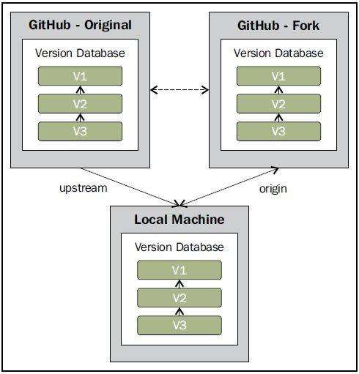

Slide 124
After clone you can work on repo as it is your repo
Make changes, commit push/pull all happens in your repo
Only when you want to contribute your changes to original repo you can create pull request
Social Coding
-
Forking a repository

Slide 125
Social Coding
A pull request is a way to tell the original author, "Hey! I did something interesting using your original code. Do you want to take a look and integrate my work, if you ﬁnd it good enough?"
-
Forking a repository

Slide 126
As you are not contributor to the project you can only submit your work to original repo with pull request
Author of original repo has rights to accept or reject or you changes
Social Coding
-
Forking a repository

Slide 127
Demo

Slide 128
Deleting Branches
When you are done with a branch and it is no longer needed then you can delete the branch
git branch -d contact-form
Deleting remote branch, add “r” ﬂag
git branch -dr origin/contact-form

Slide 129
Demo

Slide 130
Undoing Local Changes
If you have local changes that are not committed and want discard change then you can use following commands
Discard changes in single ﬁle
git checkout HEAD <ﬁle/to/restore>
Discard all changes that are not committed (already learned previously)
git reset --hard HEAD

Slide 131
Demo

Slide 132
Undoing Committed Changes

Slide 133
Undoing Committed Changes
Once code is committed and you feel your changes were wrong and you want to undo commits
You can undo committed changes using following commands:
git revert <commitHash>
git reset --hard <commitHash>

Slide 134
git revert <commitHash>
This command does not actually delete any commit.
Instead it reverts the effects of a certain commit, effectively undoing it.
It does this by producing a new commit with changes that revert each of the changes in that unwanted commit.
For example, if your original commit added a word in a certain place, the reverting commit will remove exactly this word, again.

Slide 135
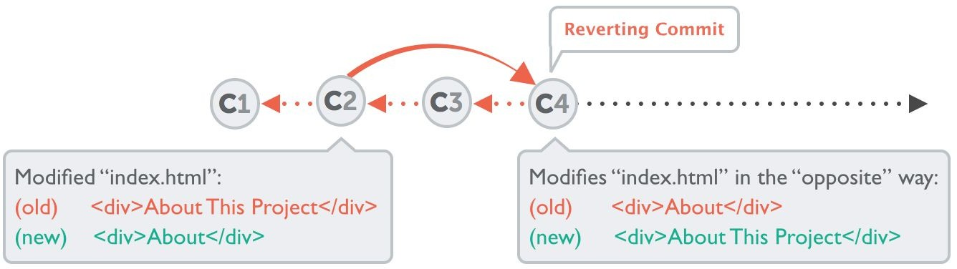
git revert <commitHash>
For example: git revert 2b504be

Slide 136
git reset --hard <commitHash>
It neither produces any new commits nor does it delete any old ones.
It works by resetting your current HEAD branch to an older revision (also called “rolling back” to that older revision):
If you call it with “--keep” instead of “--hard”, all changes from rolled back revisions will be preserved as local changes in your working directory.

Slide 137
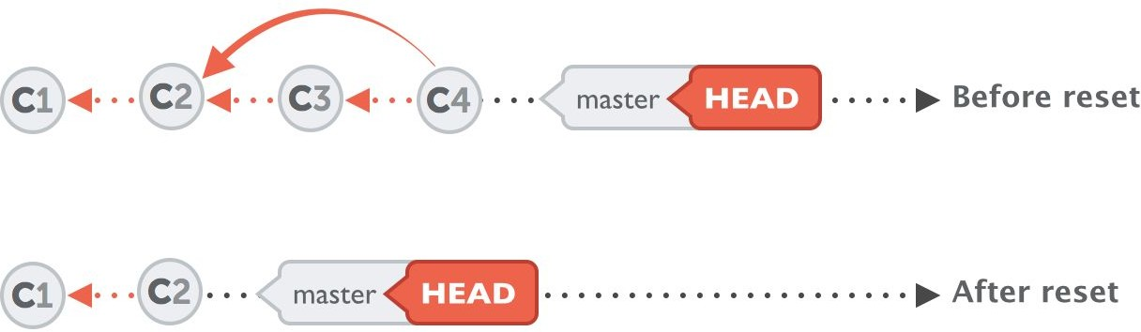
git reset --hard <commitHash>
For example: git reset --hard 2be18d9
Preserved as local changes : git reset --keep 2be18d9

Slide 138
Demo

Slide 139
Rebase

Slide 140
Rebase as an Alternative to Merge
Merging is deﬁnitely the easiest and most common way to integrate changes.
But merging is not the only one: “Rebase” is an alternative means of integration.
Rebasing is quite a bit more complex than merging

Slide 141
Rebase
--
Two possibilities
Understand merge ﬁrst
Fast-Forward
Merge Commit

Slide 142
Understand merge ﬁrst : Fast-Forward
In very simple cases, one of the two branches doesn‘t have any new commits since the branching happened - its latest commit is still the common ancestor.

Slide 143
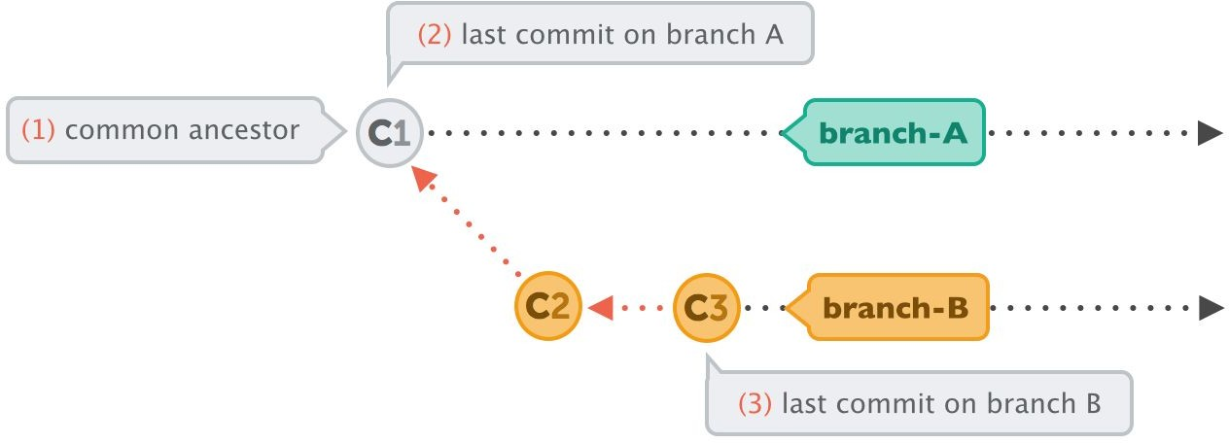
Understand merge ﬁrst : Fast-Forward
Only one branch has new commits

Slide 144
Understand merge ﬁrst : Fast-Forward
In this case, performing the integration is dead simple
Git can just add all the commits of the other branch on top of the common ancestor commit.
In Git, this simplest form of integration is called a
“fast-forward” merge. Both branches then share the exact same history.

Slide 145
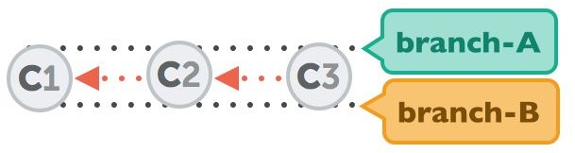
Understand merge ﬁrst : Fast-Forward
Both branch have same history after fast-forward

Slide 146
Demo

Slide 147
Understand merge ﬁrst : Merge Commit
In a lot of cases, however, both branches moved forward individually.
And can have different commits

Slide 148
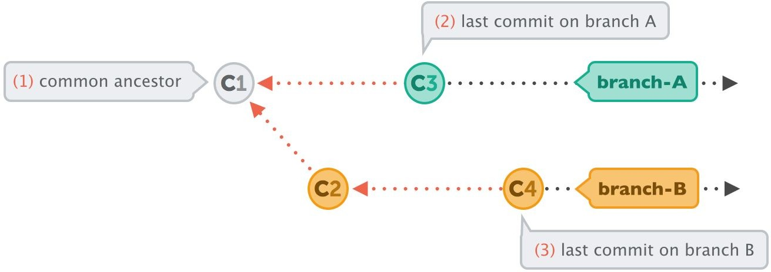
Understand merge ﬁrst : Merge Commit
Both branches have commits that are done after branch created

Slide 149
Understand merge ﬁrst : Merge Commit
To make an integration, Git will have to create a new commit that contains the differences between them - the merge commit.

Slide 150
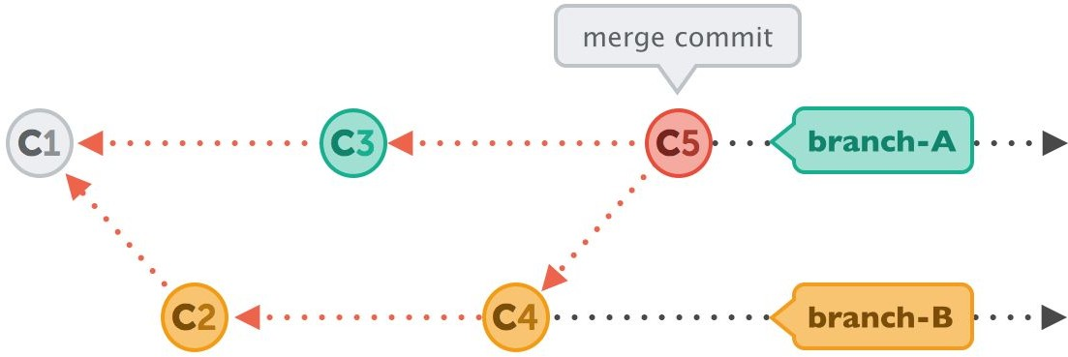
Understand merge ﬁrst : Merge Commit
Git automatically created merge commit “C5”

Slide 151
Demo

Slide 152
Rebase
Sometimes we prefer to go without such automatic merge commits.
We want the project’s history to look as if it had evolved in a single, straight line.
No indication remains that it had been split into multiple branches at some point.

Slide 153
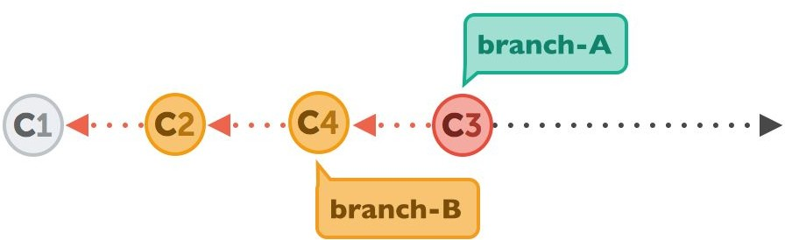
Rebase

Slide 154
Rebase
Let‘s walk through a rebase operation step by step.
The scenario is the same as in the previous examples: we want to integrate the changes from branch-B into branch-A, but now by using rebase.

Slide 155
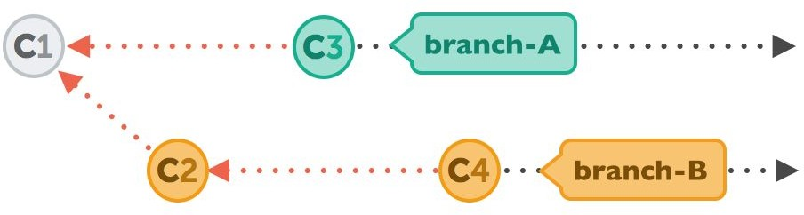
Rebase
Same scenario as we did with Merge

Slide 156
Rebase Command
git rebase <BranchName>
git rebase branch-B

Slide 157
Rebase -- Step 1
First, Git will “undo” all commits on branch-A that happened after the lines began to branch out (after the common ancestor commit).
However, of course, it won’t discard them: instead you can think of those commits as being “saved away temporarily”.

Slide 158
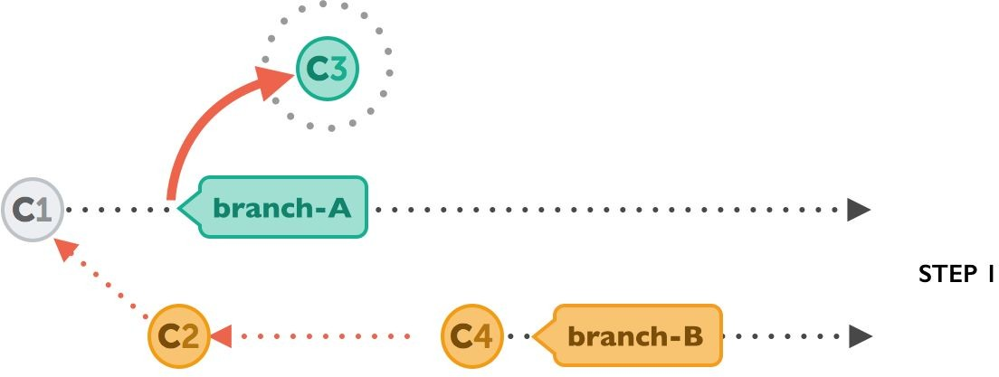
Rebase -- Step 1
Undo all commits on branch-A after common ancestor

Slide 159
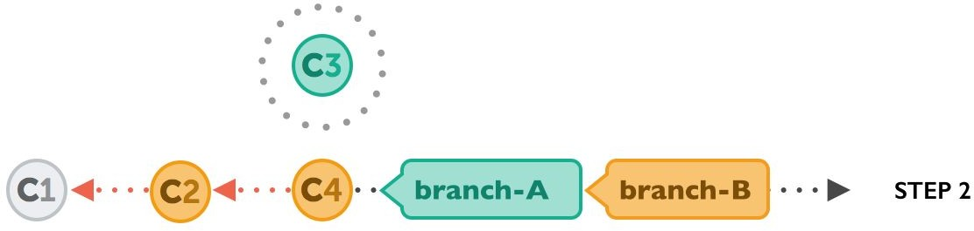
Rebase -- Step 2
Next, it applies the commits from branch-B that we want to integrate. At this point, both branches look exactly the same.

Slide 160
Rebase -- Step 3
In the ﬁnal step, the new commits on branch-A are now reapplied - but on a new position, on top of the integrated commits from branch-B (they are re-based).
The result looks like development had happened in a straight line.
Instead of a merge commit that contains all the combined changes, the original commit structure was preserved.
❖

Slide 161
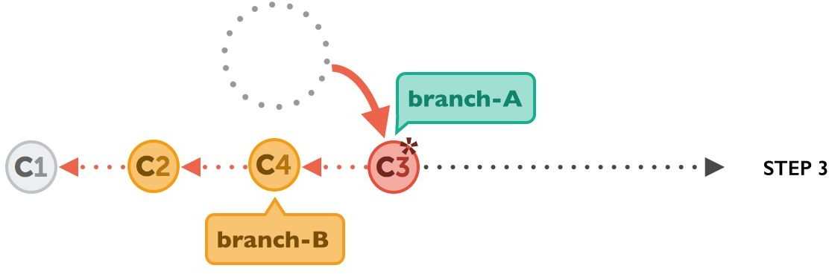
Rebase -- Step 3
Applying Branch A commits in the end

Slide 162
The Pitfalls of Rebase
Of course, using rebase isn‘t just sunshine and roses. You can easily shoot yourself in the foot if you don‘t mind an important fact: rebase rewrites history.
As you might have noticed in the last diagram above, commit “C3*” has an asterisk symbol added.
This is because, although it has the same contents as “C3”, it‘s effectively a different commit.

Slide 163
The Pitfalls of Rebase
The reason for this is that it now has a new parent commit (C4, which it was rebased onto, compared to C1, when it was originally created).
Rewriting history in such a way is unproblematic as long as it only affects commits that haven‘t been published, yet
If it is published then, some other developer might have based his work on on original C3, this will make it more and more complex

Slide 164
The Pitfalls of Rebase
Therefore, you should use rebase only for cleaning up your local work - but never to rebase commits that have already been published.

Slide 165
Demo

Slide 166
Markdown

Slide 167
Markdown
Markdown is a lightweight markup language that you can use to add formatting elements to plaintext text documents.
Created by John Gruber in 2004, Markdown is now one of the world’s most popular markup languages.
Markdown is often used to format readme ﬁles, for writing messages in online discussion forums, and to create rich text using a plain text editor.

Slide 168
GitHub Flavored Markdown (GFM)
Github release its own markdown language based on original markdown
So to format readme ﬁle we can use markdown syntax

Slide 169
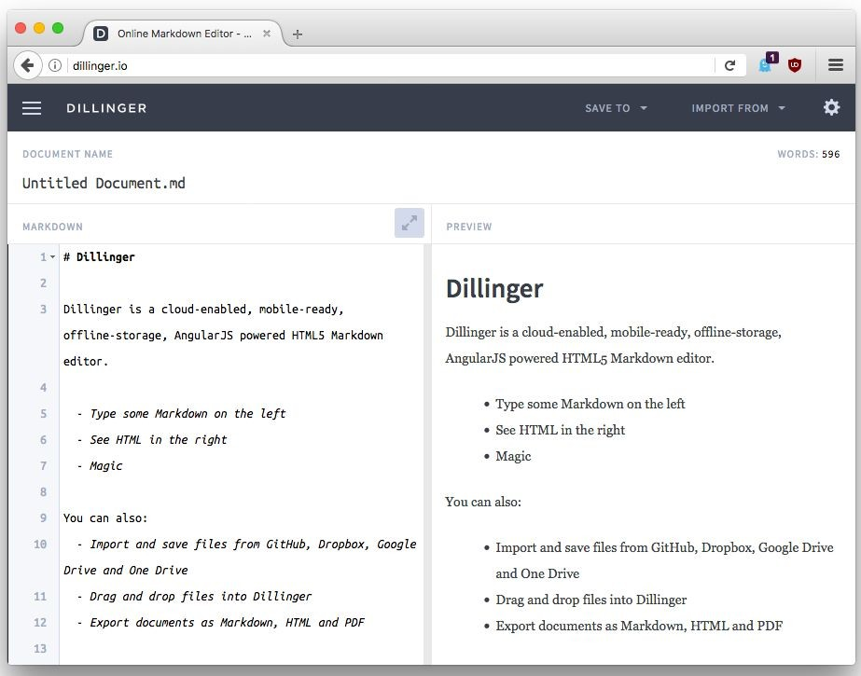

Slide 170
Basic writing and formatting syntax
Heading
Styling text
Quoting text
Quoting code
Links
List
Task List

Slide 171
Heading
To create a heading, add one to six # symbols before your heading text.

Slide 172
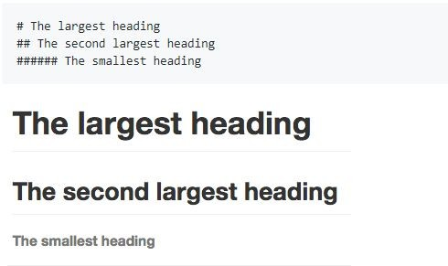

Slide 173
Styling text
You can indicate emphasis with bold, italic, or strikethrough text.

Slide 174
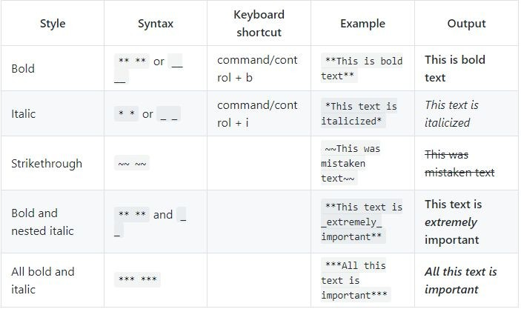

Slide 175
Quoting text
You can quote text with a >

Slide 176
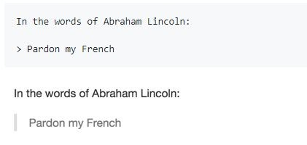

Slide 177
Quoting code
You can call out code or a command within a sentence with single backticks. The text within the backticks will not be formatted.

Slide 178
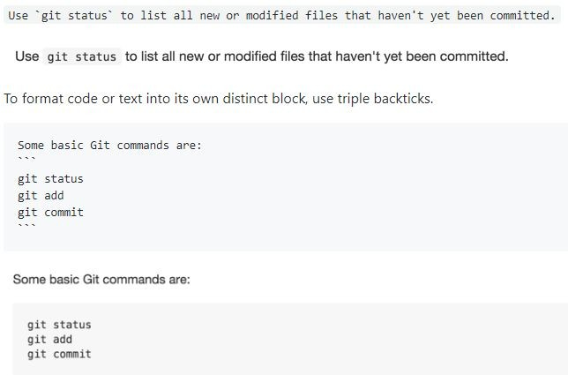

Slide 179
Links
You can create an inline link by wrapping link text in brackets [ ], and then wrapping the URL in parentheses ( ). You can also use the keyboard shortcut command + k to create a link.

Slide 180


Slide 181
Lists
You can make an unordered list by preceding one or more lines of text with - or *

Slide 182
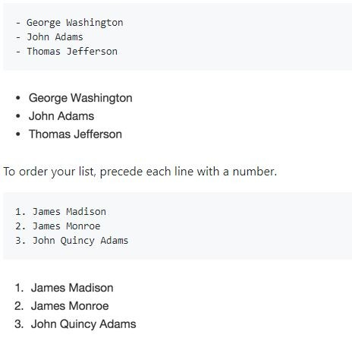

Slide 183
Nested Lists
You can create a nested list by indenting one or more list items below another item.

Slide 184
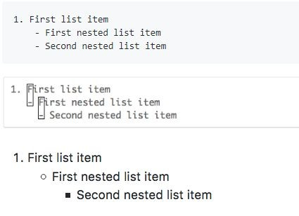

Slide 185
Task lists
To create a task list, preface list items with a regular space character followed by [ ]. To mark a task as complete, use [x]

Slide 186
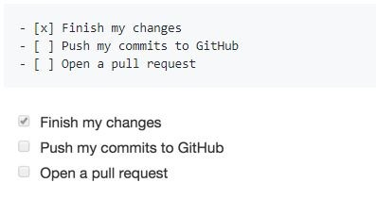

Slide 187
Demo

Slide 188
Resources
https://www.amazon.com/Learn-Version-Control-step-step/dp/1 520786506
https://www.git-tower.com/learn/git/ebook
https://git-scm.com/book/en/v2/Git-Branching-Rebasing
http://git-scm.com/book/en/v2/Git-Branching-Remote-Branche# Tracking-Branches
https://help.github.com/en/articles/basic-writing-and-formatting
-syntax

Slide 189
Zeeshan Hanif
Director/CTO Panacloud PIAIC

